Slide 1

React Stateful Components

Slide 2


React Components Promote Reusability
VS
Good
Bad

Slide 3
We’ve been here before
React is a framework for organizing our code.
Separation of concerns - all view-related code on the front-end rather than the server. (this allows us to respond to user input faster)

Slide 4
JSX Compilation
JSX
Compiles to …
<div className=”yo”>
<ul>
<li>LOL</li>
<li>OMG</li>
<li>IDK</li>
</ul>
</div>
React.createElement(‘div’, {className: ”yo”},
React.createElement(‘ul’, null,
React.createElement(‘li’, null, ‘LOL’),
React.createElement(‘li’, null, ‘OMG’),
React.createElement(‘li’, null, ‘IDK’)
)
);

Slide 5
JSX Compilation
JSX
Compiles to …
<GroceryList
groceries = {groceries} />
React.createElement(
GroceryList,
{groceries: groceries},
nil
);

Slide 6
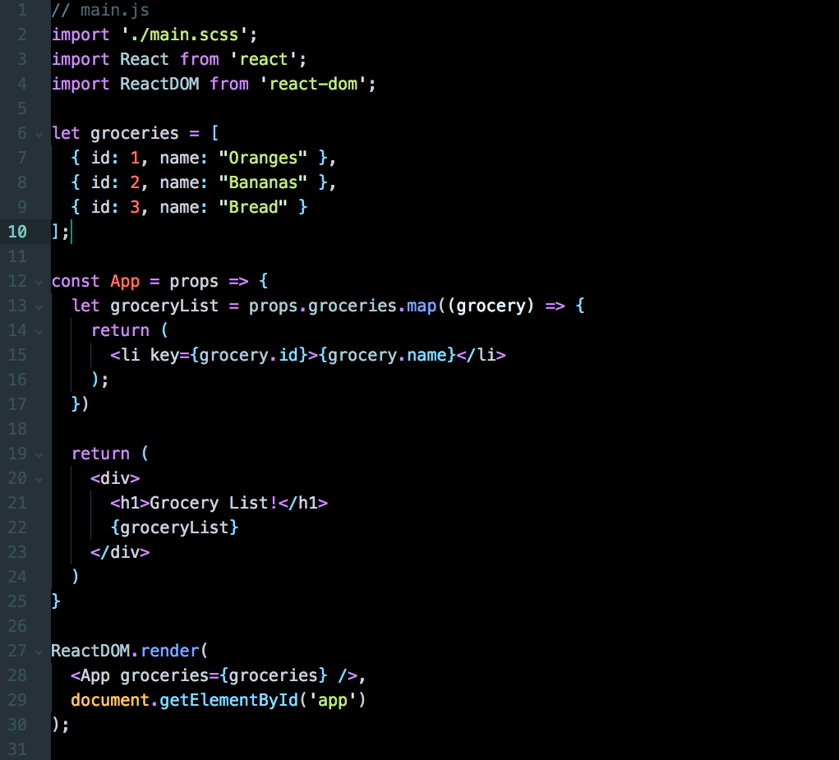
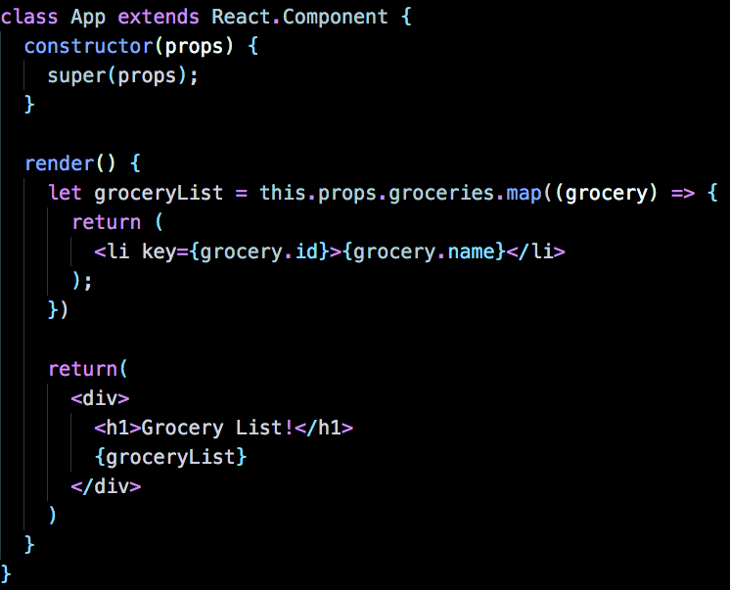
mocked data hash
our App component
pass groceries to App and render on page

Slide 7
Mocked Data Hash

Slide 8
The App Component
Props? What are props? Do we need them? Let’s find out!

Slide 9
Create and render an App

Slide 10
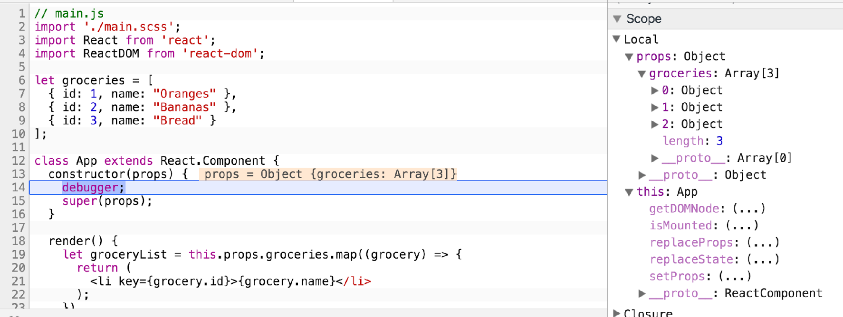
A new instance of App is created using props

Slide 11
React App Structure
What is state, and why do we need it?

Slide 12
Modified Grocery List
Our current Grocery List is static. Let's add some user interactivity:
Click on one of the grocery items
It should say "SELECTED"
All other grocery items should not be SELECTED

Slide 13
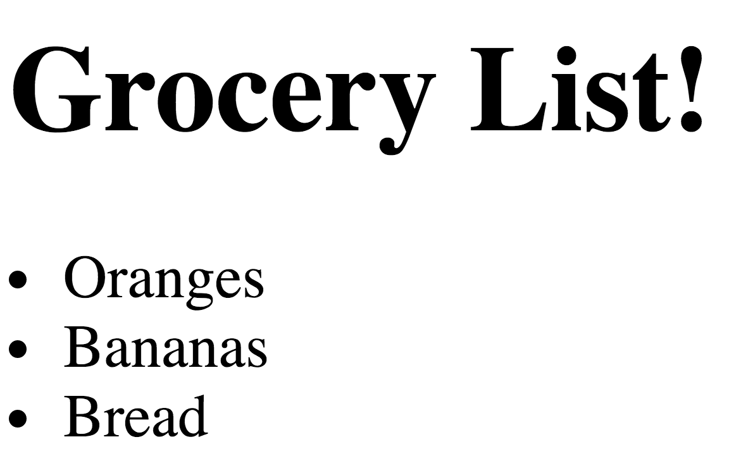
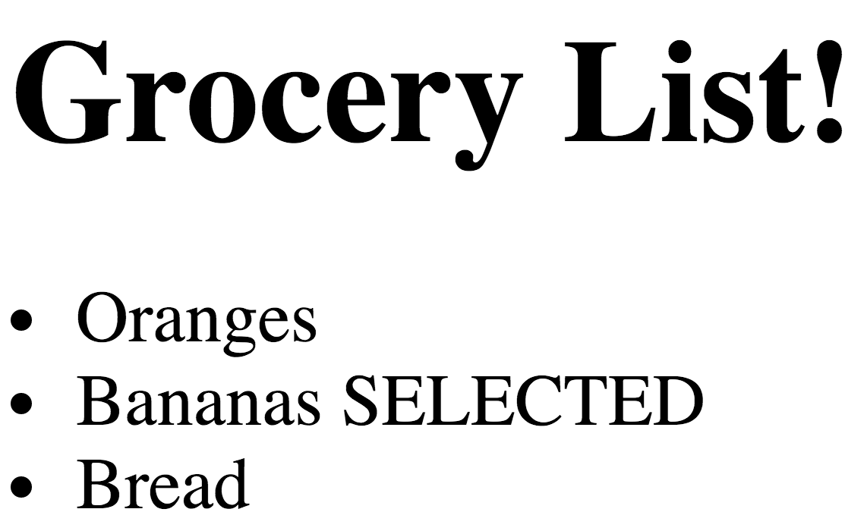
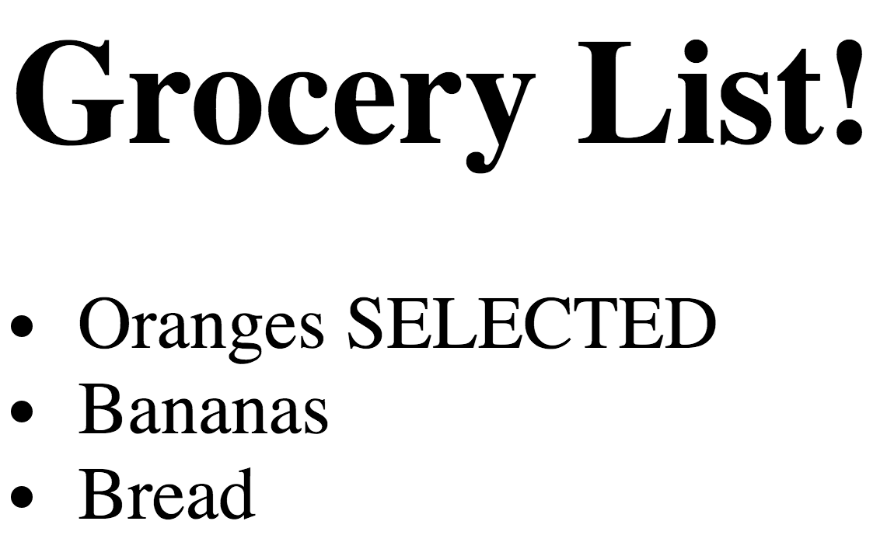
Modified Grocery List
Click on
Bananas
Click on
Oranges
Nothing Selected
Bananas Selected
Oranges Selected
Bananas De-Selected

Slide 14
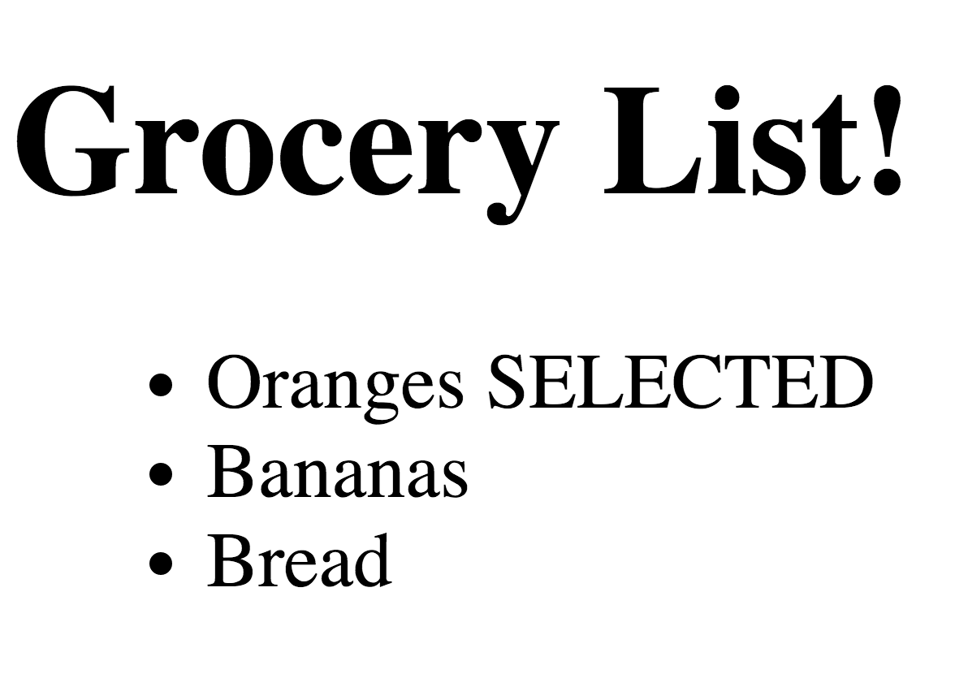
How do we model this?
App
GroceryList
Grocery

Slide 15
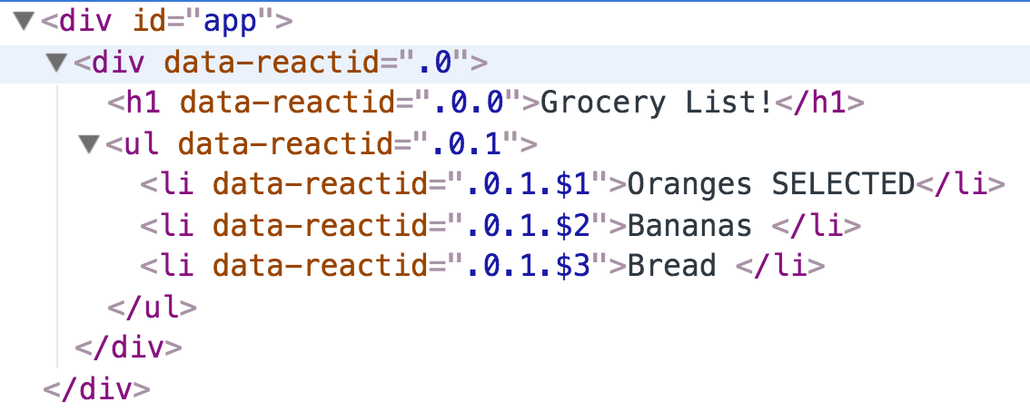
Here's what it looks like in the DOM
This helps map out the JSX we want each component to render

Slide 16
Recall Parent/Child Relationships
App

Slide 17
Recall Parent/Child Relationships
App
GroceryList

Slide 18
Recall Parent/Child Relationships
App
GroceryList
Grocery
Grocery
Grocery

Slide 19
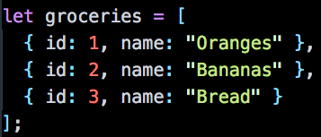
Props are passed down as data between components
App

Slide 20
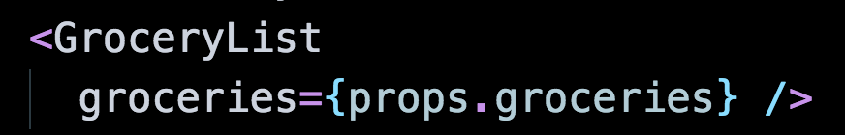
Props are passed down as data between components
App
GroceryList

Slide 21
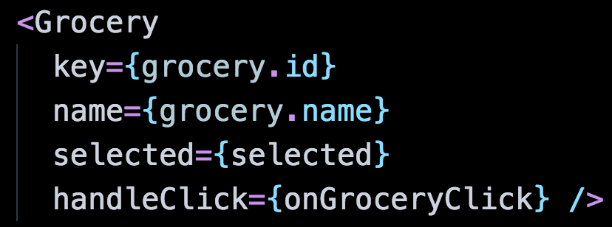
Props are passed down as data between components
App
GroceryList
Grocery
Grocery
Grocery

Slide 22
Props are passed down as data between components
App
GroceryList
Grocery
Grocery
Grocery
Don't worry about these for now!

Slide 23
So how do we track user input?
Or rather – where do we track user input?
Right now, all we have is static data passed down as props
Ideas?
Don't worry about these for now!

Slide 24
React State
What is state, and why do we need it?

Slide 25
Modified Grocery List (again)
Our current Grocery List is static. Let's add some user interactivity:
Click on one of the grocery items
It should say "SELECTED"
All other grocery items should not be SELECTED

Slide 26
Modeling State
Click on one of the grocery items
It should say "SELECTED"
All other grocery items should not be SELECTED
Two Observations:
We need an attribute like selectedGroceryId that would change depending on the grocery item clicked
This change actually affects ALL grocery items
(remove "SELECTED" from currently selected, add "SELECTED" to new selected)

Slide 27
So where would we put state?
App
GroceryList
Grocery
Grocery
Grocery
Don't worry about these for now!

Slide 28
So where would we put state?
App
GroceryList
Grocery
Grocery
Grocery

Slide 29
So where would we put state?
App
GroceryList
Grocery
Grocery
Grocery
Can't be here, since the state affects multiple Grocery items

Slide 30
So where would we put state?
App
This is really just a container
GroceryList
Grocery
Grocery
Grocery
Can't be here, since the state affects multiple Grocery items

Slide 31
So where would we put state?
App
This is really just a container
GroceryList
Let's put it on GroceryList
Grocery
Grocery
Grocery
Can't be here, since the state affects multiple Grocery items

Slide 32
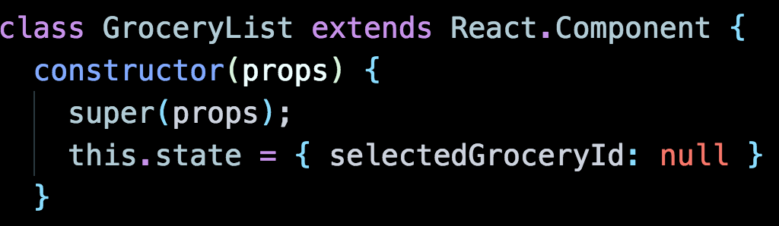
To make GroceryList stateful, it needs to be a class
Notes:
CHANGE THIS

Slide 33
To make GroceryList stateful, it needs to be a class
We want to update selectedGroceryId when a Grocery item is clicked

Slide 34
To make GroceryList stateful, it needs to be a class
We want to update selectedGroceryId when a Grocery item is clicked
Ideas?

Slide 35
How to update state when Grocery item is clicked?
This is really two things:
Update state
Bind this to a click action on specific child (Grocery) item

Slide 36
Update state
We alter state by using the method this.setState()
Never modify state by using this.state() to anywhere outside the constructor() (i.e., after it has been initialized)

Slide 37
Trigger changes based on child element
We need an event listener: onClick
Attach this to a specific DOM node that gets clicked - the Grocery item
But each Grocery item needs its own specific event listener

Slide 38
Let's pseudocode
change state here
this.setState({ selectedGroceryId: id
})
GroceryList
Grocery
id: 1
Grocery
id: 2
Grocery
id: 3
onClick
change GroceryList state to selectedGroceryId: 1
onClick
change GroceryList state to selectedGroceryId: 2
onClick
change GroceryList state to selectedGroceryId: 3

Slide 39
Let's pseudocode
change state here
this.setState({ selectedGroceryId: id
})
GroceryList
Grocery
id: 1
Grocery
id: 2
Grocery
id: 3
onClick
change GroceryList state to selectedGroceryId: 1
onClick
change GroceryList state to selectedGroceryId: 2
onClick
change GroceryList state to selectedGroceryId: 3
How can we assign a different function to each item?

Slide 40
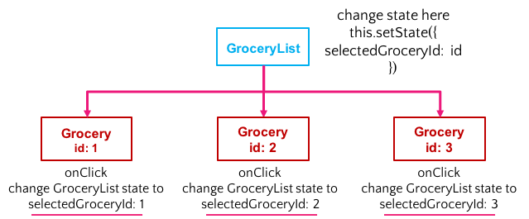
Let's pseudocode
Define a function on GroceryList that changes state
Each of these functions needs to be specific to a Grocery item
This function needs to be passed down to Grocery as props
In Grocery, we need to assign this function to handle the onClick event
Notes:
This method needs to live on GroceryList because that's where state is

Slide 41
Let's pseudocode
This function lives on GroceryList because:
that's where state is
it is the parent component and can pass functions down to children
Define a function on GroceryList that changes state
Each of these functions needs to be specific to a Grocery item
This function needs to be passed down to Grocery as props
In Grocery, we need to assign this function to handle the onClick event
Because props is how we pass data from parent to child components
Notes:
This method needs to live on GroceryList because that's where state is

Slide 42
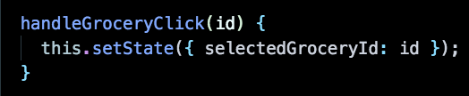
Define function on GroceryList to change state
Define a function on GroceryList that changes state
Each of these functions needs to be specific to a Grocery item
This function needs to be passed down to Grocery as props
In Grocery, we need to assign this function to handle the onClick event
src/GroceryList.js
Notes:
This method needs to live on GroceryList because that's where state is

Slide 43
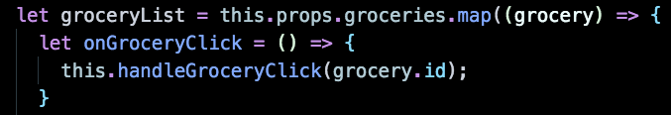
Make each function specific to a given Grocery item
Define a function on GroceryList that changes state
Each of these functions needs to be specific to a Grocery item
This function needs to be passed down to Grocery as props
In Grocery, we need to assign this function to handle the onClick event
src/GroceryList.js
Notes:
This method needs to live on GroceryList because that's where state is

Slide 44
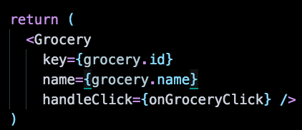
Make each function specific to a given Grocery item
Define a function on GroceryList that changes state
Each of these functions needs to be specific to a Grocery item
This function needs to be passed down to Grocery as props
In Grocery, we need to assign this function to handle the onClick event
src/GroceryList.js

Slide 45
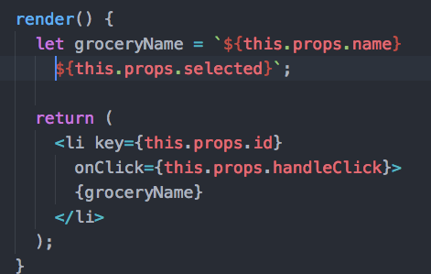
Make each function specific to a given Grocery item
Define a function on GroceryList that changes state
Each of these functions needs to be specific to a Grocery item
This function needs to be passed down to Grocery as props
In Grocery, we need to assign this function to handle the onClick event
src/Grocery.js
Notes:
This method needs to live on GroceryList because that's where state is

Slide 46
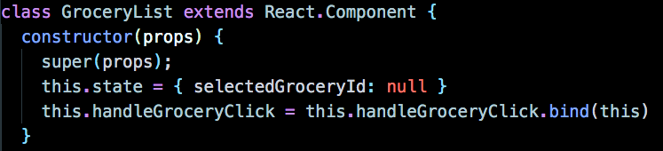
One more thing…
For functions passed down as props, bind this in your constructor method.
Doing so ensures that this will always refer to the component that defined the event handler rather than the child component receiving the event handler as a prop.

Slide 47
One more thing…
For functions passed down as props, bind this in your constructor method.
Doing so ensures that this will always refer to the component that defined the event handler rather than the child component receiving the event handler as a prop.
GroceryList
Grocery

Slide 48
Putting It All Together

Slide 49
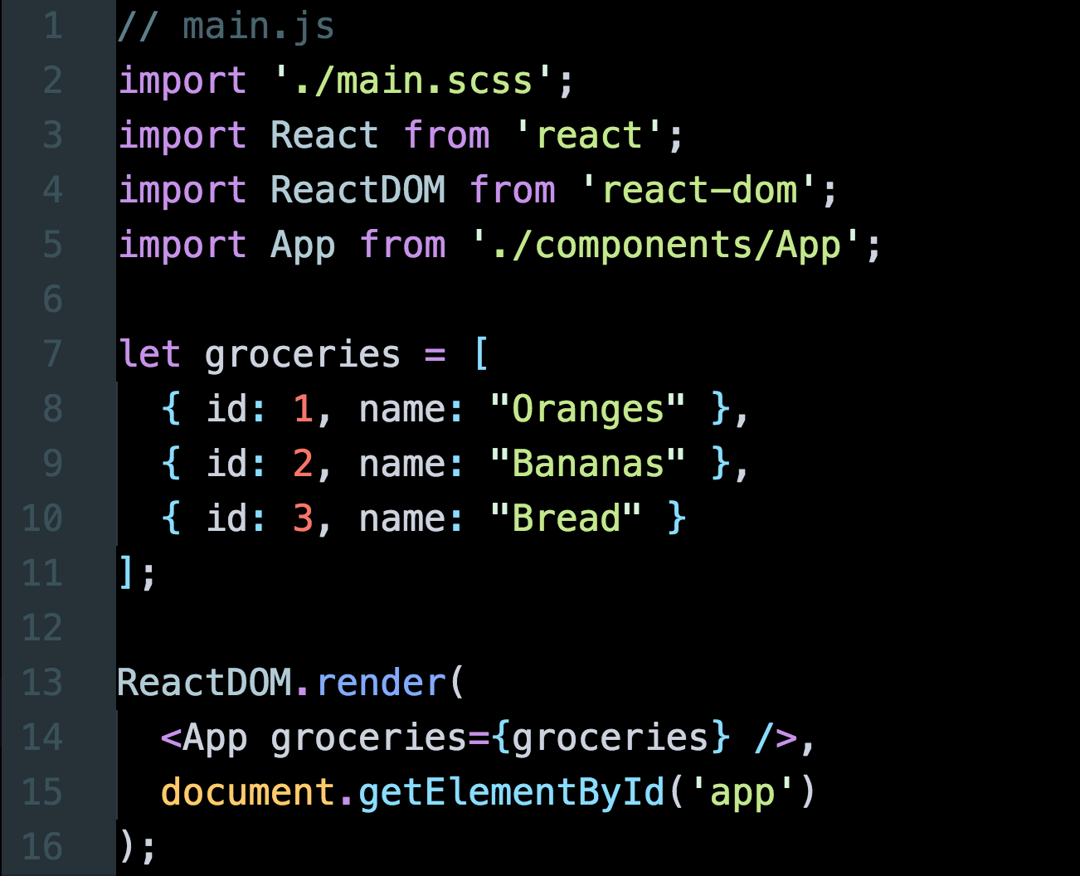
src/main.js

Slide 50
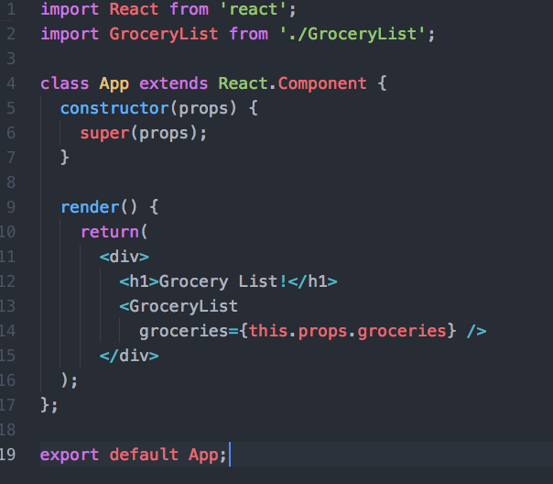
src/App.js

Slide 51
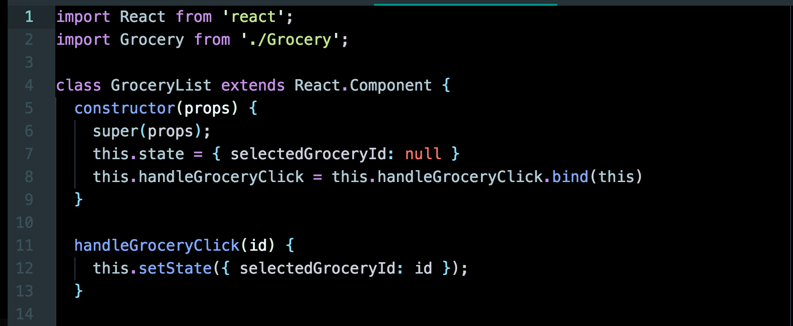
src/GroceryList.js (Part 1)

Slide 52
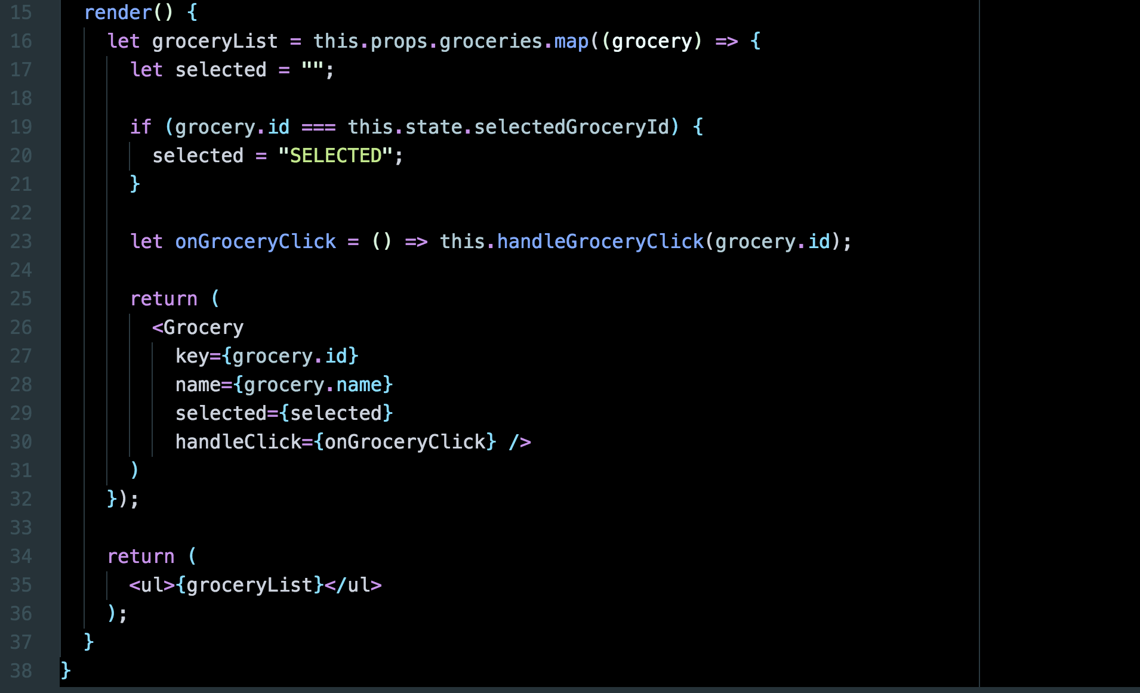
src/GroceryList.js (Part 2)

Slide 53
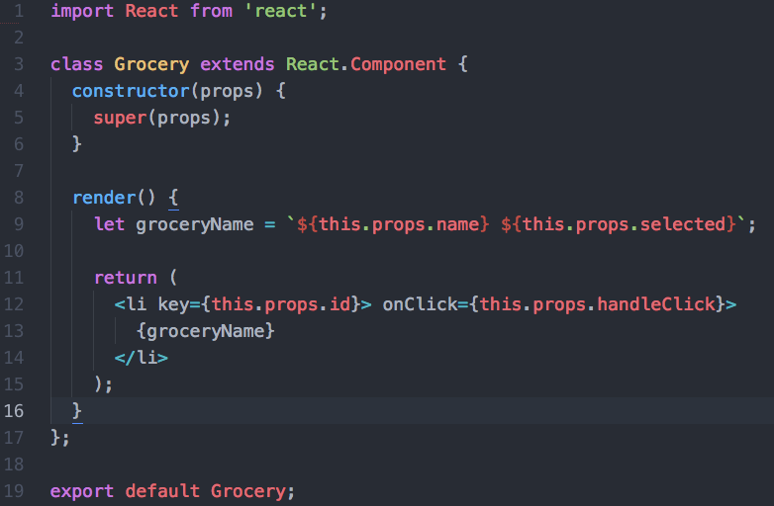
src/Grocery.js

